Slide 1
ECE 5706: Resilient Computer System Design
Error Detection & Correction
Xin Xin
Assistant Professor
Electrical and Computer Engineering
ACKNOWLEDGEMENT:
Prof. Behrooz Parhami at UCSB
Prof. Ronald F. DeMara at UCF
Notes:
<number>

Slide 2
Hamming Distance
Definition: Hamming distance between two bit-vectors is
the number of positions in which they differ
Correctable
error
A distance-2 code:
00011
00101
00110
01001
01010
01100
10001
10010
10100
11000
Detectable
error
00111 (0→1 error)
00100 (1→0 error)
4 3 2 1
Code-
word
Noncode-
word
Codeword
Min H-dist Code capability
2 d = 1; SED
3 c = 1; SEC or (d = 2; DED)
4 c = 1 and d = 2; SEC/DED
5 c = 2 or (c = 1 and d = 3; SEC/3ED)
h cEC/dED such that h = c + d + 1
d ≥ c, so that d – c represents the add’l detection capability
Part IV – Errors: Informational Distortions
Slide <number>
Notes:
<number>

Slide 3
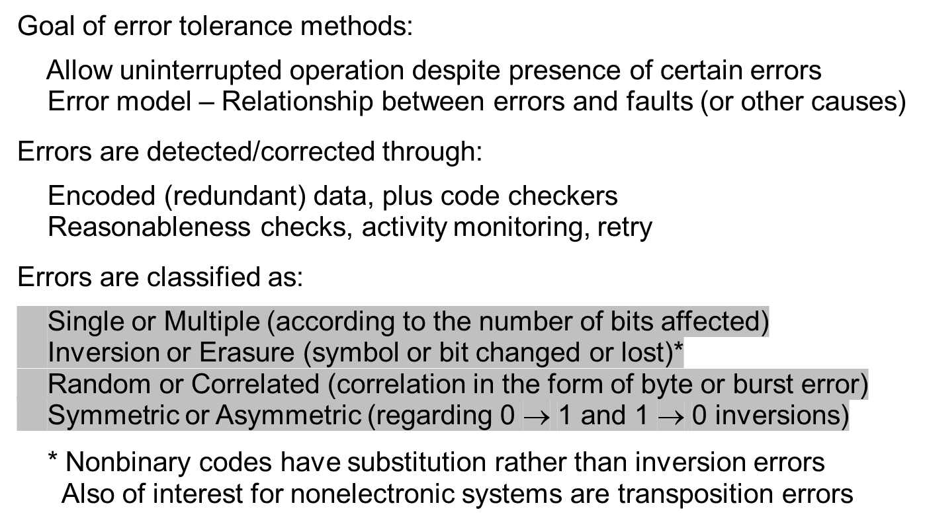
Error Classification and Models
Part IV – Errors: Informational Distortions
Slide <number>

Slide 4
Error Detection in Natural Language Texts
ERROR
ERROR
ERROR
Erasure errors
EQROR
ERROR
Substitution error
ERROR
ERORR
ERROR
Transposition error
Part IV – Errors: Informational Distortions
Nov. 2020
Slide <number>

Slide 5
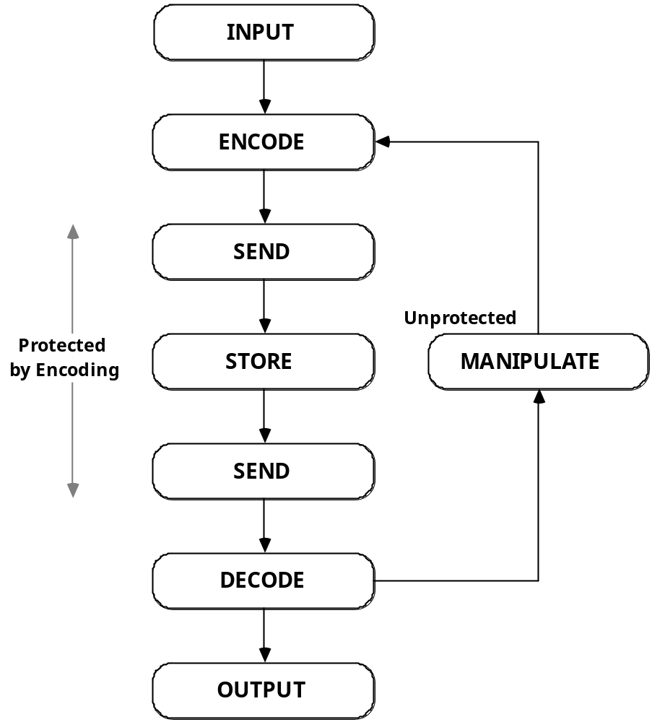
Application of Coding to Error Control
Ordinary codes can be used for storage and transmission errors; they are not closed under arithmetic / logic operations
Error-detecting, error-correcting, or combination codes (e.g., Hamming SEC/DED)
Arithmetic codes can help detect
(or correct) errors during data manipulations:
1. Product codes (e.g., 15x)
2. Residue codes (x mod 15)
A common way of applying information coding techniques
Part IV – Errors: Informational Distortions
Nov. 2020
Slide <number>

Slide 6
The Concept of Error-Detecting Codes
Data space
Code space
Encoding
Data words
Codewords
Errors
Decoding
Noncodewords
Error space
The simplest possible error-detecting code:
Attach an even parity bit to each k-bit data word
Check bit = XOR of all data bits
Data space: All 2^{k} possible k-bit words
Code space: All 2^{k} possible even-parity (k + 1)-bit codewords
Error space: All 2^{k} possible odd-parity (k + 1)-bit noncodewords
Detects all single-bit errors
1
0 0 1 0 1 0 0 0 1 1
Part IV – Errors: Informational Distortions
Nov. 2020
Slide <number>
Notes:
<number>

Slide 7
Evaluation of Error-Detecting Codes
Redundancy: k data bits encoded in n = k + r bits (r redundant bits)
Encoding: Complexity (cost / time) to form codeword from data word
Decoding: Complexity (cost / time) to obtain data word from codeword
Separable codes have computation-free decoding
Capability: Classes of error that can be detected
Greater detection capability generally involves more redundancy
To detect d bit-errors, a minimum code distance of d + 1 is required
Examples of code detection capabilities:
Single, double, b-bit burst, byte, unidirectional, . . . errors
Closure: Arithmetic and other operations done directly on codewords
(rather than in 3 stages: decode, operate, and encode)
Part IV – Errors: Informational Distortions
Nov. 2020
Slide <number>
Notes:
<number>

Slide 8
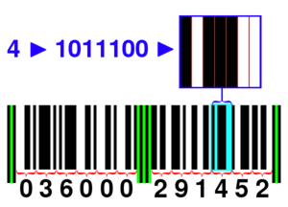

13.2 Checksum Codes
Ex.: 12-digit UPC-A universal product code—Computing the check digit:
Add the odd-indexed digits and multiply the sum by 3
Add the sum of even-indexed digits to previous result
Subtract the total from the next higher multiple of 10
Example:
Sum odd indexed digits: 0 + 6 + 0 + 2 + 1 + 5 = 14
Multiply by 3: 14 × 3 = 42
Add even-indexed digits: 42 + 3 + 0 + 0 + 9 + 4 = 58
Compute check digit: 60 – 58 = 2
1 2 3 4 5 6 7 8 9 10 11
Checking:
Verify that weighted mod-10 sum of all 12 digits is 0
Bar code uses 7 bits per digit, with different encodings on the right and left halves and different parities at various positions
Part IV – Errors: Informational Distortions
Nov. 2020
Slide <number>
Notes:
<number>

Slide 9
Characterization of Checksum Codes
Given a data vector x₁, x₂, . . . , x_{n}, encode the data by attaching the checksum x_{n+1} to the end, such that Σ_{j=1 to n+1} w_{j} x_{j} = 0 mod A
The elements w_{j} of the weight vector w are predetermined constants
Example:
For the UPC-A checksum scheme, we have
w = 3, 1, 3, 1, 3, 1, 3, 1, 3, 1, 3, 1
A = 10
Checking:
Verify that weighted mod-A sum of all elements is 0
1 2 3 4 5 6 7 8 9 10 11
Capabilities:
Detects all errors adding an error magnitude that is not a multiple of A
Variant: Vector elements may be XORed rather than added together
Part IV – Errors: Informational Distortions
Nov. 2020
Slide <number>
Notes:
<number>

Slide 10
13.3 Weight-Based and Berger Codes
Constant-weight codes
Definition: All codewords have the same number of 1s
A weight-2 code:
00011
00101
00110
01001
01010
01100
10001
10010
10100
11000
Can detect all unidirectional errors
Maximum number of codewords obtained when weight of n-bit codewords is n/2
Part IV – Errors: Informational Distortions
Nov. 2020
Slide <number>
Notes:
<number>

Slide 11
Berger Codes
Definition: Separable code that has the count of 0s within the data part attached as a binary number that forms the check part
Alternative – attach the 1’s-complement of the number of 1s
A Berger code:
000000 110
000001 101
000010 101
000011 100
. . .
100111 010
101000 100
. . .
111110 001
111111 000
Can detect all unidirectional errors
⎡log₂(k + 1)⎤ check bits for k data bits
Check part
Jay M. Berger
(IBM)
Part IV – Errors: Informational Distortions
Slide <number>
Notes:
<number>

Slide 12
13.4 Cyclic Codes
Definition: Any cyclic shift of a codeword produces another codeword
A k-bit data word corresponds to a polynomial of degree k – 1
Data = 1101001: D(x) = 1 + x + x³ + x⁶ (addition is mod 2)
The code has a generator polynomial of degree r = n – k
G(x) = 1 + x + x³
To encode data (1101001), multiply its associated polynomial by G(x)
1 + x + x³ + x⁶
× 1 + x + x³
1 + x + x³ + x⁶ + x + x² + x⁴ + x⁷ + x³ + x⁴ + x⁶ + x⁹
1 + x² + x⁷ + x⁹
1 0 1 0 0 0 0 1 0 1
Detects all burst errors of width less than n – k
Burst error polynomial x^{j}E(x), where E(x) is of degree less than n – k
Part IV – Errors: Informational Distortions
Slide <number>
Notes:
<number>

Slide 13
Cyclic Codes: Encoding and Decoding
Encoding: Multiplication by the generator polynomial G(x)
G(x):
x³
FF
FF
x
FF
1
V(x)
D(x)
Decoding: Division by the generator polynomial G(x)
V(x)
B(x)
D(x)
G(x):
x³
FF
FF
x
FF
1
B(x) = (x + x³) D(x) V(x) = D(x) + B(x) = (1 + x + x³) D(x)
Part IV – Errors: Informational Distortions
Slide <number>
Notes:
<number>

Slide 14
Separable Cyclic Codes
Let D(x) and G(x) be the data and generator polynomials
Encoding:
Multiply D(x) by x^{n–k} and divide the result by G(x) to get the remainder polynomial R(x) of degree less than n – k
Form the codeword V(x) = R(x) + x^{n–k}D(x), which is divisible by G(x)
Example: 7-bit code with 4 data bits and 3 check bits, G(x) = 1 + x + x³
Data = 1 0 0 1, D(x) = 1 + x³
x³D(x) = x³ + x⁶ = (x + x²) mod (1 + x + x³)
V(x) = x + x² + x³ + x⁶
Codeword = 0 1 1 1 0 0 1
aka CRC = cyclic
redundancy check
Single parity bit:
G(x) = x + 1
Check part Data part
Part IV – Errors: Informational Distortions
Nov. 2020
Slide <number>
Notes:
<number>

Slide 15
13.5 Arithmetic Error-Detecting Codes
Unsigned addition 0010 0111 0010 0001
+ 0101 1000 1101 0011
–––––––––––––––––
Correct sum 0111 1111 1111 0100
Erroneous sum 1000 0000 0000 0100
↑
Stage generating an
erroneous carry of 1
How a single carry error can lead to an arbitrary number of bit-errors (inversions)
The arithmetic weight of an error: Min number of signed powers of 2 that must be added to the correct value to turn it into the erroneous result (contrast with Hamming weight of an error)
Example 1 Example 2
------------------------------------------------------------------------ --------------------------------------------------------------------------
Correct value 0111 1111 1111 0100 1101 1111 1111 0100
Erroneous value 1000 0000 0000 0100 0110 0000 0000 0100
Difference (error) 16 = 2⁴ –32752 = –2¹⁵ + 2⁴
Min-weight BSD 0000 0000 0001 0000 –1000 0000 0001 0000
Arithmetic weight 1 2
Error type Single, positive Double, negative
Part IV – Errors: Informational Distortions
Nov. 2020
Slide <number>

Slide 16
Codes for Arithmetic Operations
Arithmetic error-detecting codes:
Are characterized by arithmetic weights of detectable errors
Allow direct arithmetic on coded operands
We will discuss two classes of arithmetic error-detecting codes, both of which are based on a check modulus A (usually a small odd number)
Product or AN codes
Represent the value N by the number AN
Residue (or inverse residue) codes
Represent the value N by the pair (N, C),
where C is N mod A or (N – N mod A) mod A
Part IV – Errors: Informational Distortions
Nov. 2020
Slide <number>

Slide 17
Product or AN Codes
For odd A, all weight-1 arithmetic errors are detected
Arithmetic errors of weight ≥ 2 may go undetected
e.g., the error 32 736 = 2¹⁵ – 2⁵ undetectable with A = 3, 11, or 31
Error detection: check divisibility by A
Encoding/decoding: multiply/divide by A
Arithmetic also requires multiplication and division by A
Product codes are nonseparate (nonseparable) codes
Data and redundant check info are intermixed
Part IV – Errors: Informational Distortions
Nov. 2020
Slide <number>

Slide 18
Low-Cost Product Codes
Use low-cost check moduli of the form A = 2ª – 1
Multiplication by A = 2ª – 1: done by shift-subtract
(2ª – 1)N = 2ªN – N
Division by A = 2ª – 1: done a bits at a time as follows
Given y = (2ª – 1)x, find x by computing 2ª x – y
. . . xxxx 0000 – . . . xxxx xxxx = . . . xxxx xxxx
Unknown 2ª x Known (2ª – 1)x Unknown x
Theorem: Any unidirectional error with arithmetic weight of at most a – 1 is detectable by a low-cost product code based on A = 2ª – 1
Part IV – Errors: Informational Distortions
Nov. 2020
Slide <number>

Slide 19
Arithmetic on AN-Coded Operands
Add/subtract is done directly: Ax ± Ay = A(x ± y)
Direct multiplication results in: Aa × Ax = A²ax
The result must be corrected through division by A
For division, if z = qd + s, we have: Az = q(Ad) + As
Thus, q is unprotected
Possible cure: premultiply the dividend Az by A
The result will need correction
Square rooting leads to a problem similar to division
⎣√ A²x ⎦ = ⎣ A√ x ⎦ which is not the same as A ⎣√ x ⎦
Part IV – Errors: Informational Distortions
Nov. 2020
Slide <number>

Slide 20
Residue and Inverse Residue Codes
Represent N by the pair (N, C(N)), where C(N) = N mod A
Residue codes are separate (separable) codes
Separate data and check parts make decoding trivial
Encoding: Given N, compute C(N) = N mod A
Low-cost residue codes use A = 2ª – 1
To compute N mod (2ª – 1), add a-bit segments of N, modulo 2ª – 1
(no division is required)
Example: Compute 0101 1101 1010 1110 mod 15
0101 + 1101 = 0011 (addition with end-around carry)
0011 + 1010 = 1101
1101 + 1110 = 1100 The final residue mod 15
Part IV – Errors: Informational Distortions
Nov. 2020
Slide <number>

Slide 21
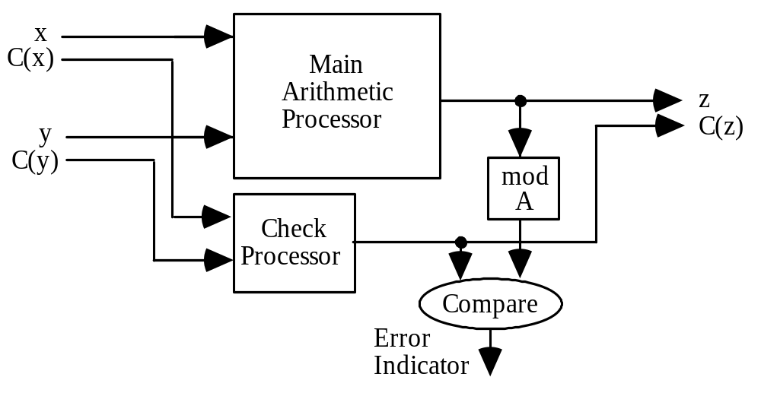
Arithmetic on Residue-Coded Operands
Add/subtract: Data and check parts are handled separately
(x, C(x)) ± (y, C(y)) = (x ± y, (C(x) ± C(y)) mod A)
Multiply
(a, C(a)) × (x, C(x)) = (a × x, (C(a)×C(x)) mod A)
Divide/square-root: difficult
Arithmetic processor with residue checking
Part IV – Errors: Informational Distortions
Nov. 2020
Slide <number>

Slide 22
13.6 Other Error-Detecting Codes
Codes for erasure errors
Assume n total symbols, k info symbol, n – m erasures allowed
Info can be recovered from any m symbols in an n-symbol codeword
When m = k, the erasure code is optimal
Codes for byte errors
Bytes are common units of data representation, storage, transmission
So, it makes sense to tie our error detection capability to bytes
Example: Single-byte-error-correcting, double-byte-error-detecting code
Codes for burst errors
With serial data or scratched disk surface, adjacent bits can be affected
Example: Single-bit-error-correcting, 6-bit-burst-error-detecting code
Part IV – Errors: Informational Distortions
Slide <number>
Notes:
<number>

Slide 23
Higher-Level Error Coding Methods
We have applied coding to data at the bit-string or word level
It is also possible to apply coding at higher levels
Data structure level – Robust data structures
Application level – Algorithm-based error tolerance
Part IV – Errors: Informational Distortions
Nov. 2020
Notes:
<number>

Slide 24
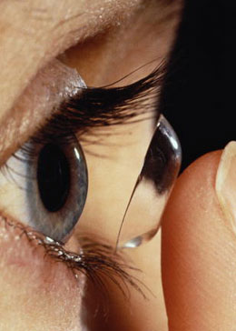
Error Correction
Part IV – Errors: Informational Distortions
Nov. 2020
Slide <number>
Notes:
<number>

Slide 25
The Concept of Error-Correcting Codes
To be avoided at all cost
Data space
Code space
Encoding
Data words
Codewords
Errors
Decoding
Noncodewords
Error space
A conceptually simple error-correcting code:
Arrange the k data bits into a k^{1/2} × k^{1/2} square array
Attach an even parity bit to each row and column of the array
Row/Column check bit = XOR of all row/column data bits
Data space: All 2^{k} possible k-bit words
Redundancy: 2k^{1/2} + 1 check bits for k data bits
Corrects all single-bit errors (lead to distinct noncodewords)
Detects all double-bit errors (some triples go undetected)
0
0 1 1 0
0 1 0 1
1 0 1 0
1 0 0 1
Part IV – Errors: Informational Distortions
Nov. 2020
Slide <number>
Notes:
<number>

Slide 26
Evaluation of Error-Correcting Codes
Redundancy: k data bits encoded in n = k + r bits (r redundant bits)
Encoding: Complexity (circuit / time) to form codeword from data word
Decoding: Complexity (circuit / time) to obtain data word from codeword
Capability: Classes of error that can be corrected
Greater correction capability generally involves more redundancy
To correct c bit-errors, a minimum code distance of 2c + 1 is required
Examples of code correction capabilities:
Single, double, byte, b-bit burst, unidirectional, . . . errors
Combined error correction/detection capability:
To correct c errors and additionally detect d errors (d > c),
a minimum code distance of c + d + 1 is required
Example: Hamming SEC/DED code has a code distance of 4
Part IV – Errors: Informational Distortions
Nov. 2020
Slide <number>
Notes:
<number>

Slide 27
Hamming Distance for Error Correction
The following visualization, though not completely accurate, is still useful
Red dots represent codewords
Yellow dots, noncodewords within distance 1 of codewords, represent correctable errors
Blue dot, within distance 2 of three different codewords represents a detectable error
Simultaneous single error correction and double error detection requires that there not be points within distance 2 of some codewords that are also within distance 1 of another
Part IV – Errors: Informational Distortions
Nov. 2020
Slide <number>
Notes:
<number>

Slide 28
14.2 Hamming Codes
Example: Uses multiple parity bits, each applied to a different subset of data bits
Data bits Parity bits
d₃ d₂ d₁ d₀ p₂ p₁ p₀
Encoding: 3 XOR networks to form parity bits
Checking: 3 XOR networks to verify parities
s₂ s₁ s₀ | Error
0 0 0 | None
0 0 1 | p₀
0 1 0 | p₁
0 1 1 | d₀
1 0 0 | p₂
1 0 1 | d₂
1 1 0 | d₃
1 1 1 | d₁
Decoding: Trivial (separable code)
Redundancy: 3 check bits for 4 data bits
Unimpressive, but gets better with more data bits
(7, 4); (15, 11); (31, 26); (63, 57); (127, 120)
Capability: Corrects any single-bit error
s₂ = d₃ ⊕ d₂ ⊕ d₁ ⊕ p₂
s₁ = d₃ ⊕ d₁ ⊕ d₀ ⊕ p₁
s₀ = d₂ ⊕ d₁ ⊕ d₀ ⊕ p₀
s₂ s₁ s₀ Syndrome
Part IV – Errors: Informational Distortions
Nov. 2020
Slide <number>
Notes:
<number>

Slide 29
Matrix Formulation of Hamming SEC Code
Data bits Parity bits
Data bits Parity bits
d₃ d₂ d₁ d₀ p₂ p₁ p₀
d₃
d₂
d₁
d₀
p₂
p₁
p₀
d₃ d₂ d₁ d₀ p₂ p₁ p₀
1 1 1 0 1 0 0
1 0 1 1 0 1 0
0 1 1 1 0 0 1
s₂
s₁
s₀
×
=
s₂ s₁ s₀ | Error
0 0 0 | None
0 0 1 | p₀
0 1 0 | p₁
0 1 1 | d₀
1 0 0 | p₂
1 0 1 | d₂
1 1 0 | d₃
1 1 1 | d₁
Parity check matrix
Received word
Syndrome
Syndrome matches the p₂ column in the parity check matrix
Matrix-vector multiplication is done with AND/XOR, instead of ×/+
Part IV – Errors: Informational Distortions
Nov. 2020
Slide <number>
Notes:
<number>

Slide 30
Matrix Rearrangement for Simpler Correction
Data and parity bits
Data and parity bits
p₀ p₁ d₀ p₂ d₂ d₃ d₁
p₀
p₁
d₀
p₂
d₂
d₃
d₁
p₀ p₁ d₀ p₂ d₂ d₃ d₁
0 0 0 1 1 1 1
0 1 1 0 0 1 1
1 0 1 0 1 0 1
s₂
s₁
s₀
×
=
s₂ s₁ s₀ | Error
0 0 0 | None
0 0 1 | p₀
0 1 0 | p₁
0 1 1 | d₀
1 0 0 | p₂
1 0 1 | d₂
1 1 0 | d₃
1 1 1 | d₁
1 2 3 4 5 6 7
Position number
Data and parity bits
Matrix columns are binary rep’s of column indices
s₂
s₁
s₀
Decoder
0
1-7
1-7
Syndrome indicates error in position 4
Corrected version
1-7
Part IV – Errors: Informational Distortions
Nov. 2020
Slide <number>
Notes:
<number>

Slide 31

Hamming Generator Matrix
Data bits
Data bits Parity bits
d₃ d₂ d₁ d₀
1 0 0 0
0 1 0 0
0 0 1 0
0 0 0 1
1 1 1 0
1 0 1 1
0 1 1 1
d₃ d₂ d₁ d₀ p₂ p₁ p₀
d₃
d₂
d₁
d₀
p₂
p₁
p₀
d₃
d₂
d₁
d₀
×
=
Richard W. Hamming
(Bell Labs,
Naval Postgraduate
School)
Generator matrix
Data word
Codeword
Recall that matrix-vector multiplication
is done with AND/XOR, instead of ×/+
Part IV – Errors: Informational Distortions
Nov. 2020
Slide <number>
Notes:
<number>

Slide 32
Generalization to Wider Hamming SEC Codes
Data and parity bits
Condition for general Hamming SEC code:
n = k + r = 2^{r} – 1
p₀ p₁ d₀ p₂ . . .
0 0 0 . . . 1 1 1
: : : . . . : : :
0 1 1 . . . 0 1 1
1 0 1 . . . 1 0 1
p₀
p₁
d₀
p₂
.
.
.
s_{r−1}
:
s₁
s₀
×
=
n | k = n – r
7 | 4
15 | 11
31 | 26
63 | 57
127 | 120
255 | 247
511 | 502
1023 | 1013
1 2 3 2^{r}–1
Position number
Data and parity bits
s_{r−1}
:
s₁
s₀
Decoder
Matrix columns are binary rep’s of column indices
2^{r}−1
2^{r}−1
Corrected version
2^{r}−1
Part IV – Errors: Informational Distortions
Nov. 2020
Slide <number>
Notes:
<number>

Slide 33
A Hamming SEC/DED Code
Data and parity bits
Add an extra row of all 1s and a column with only one 1 to the parity check matrix
p₀ p₁ d₀ p₂ . . .
0 0 0 . . . 1 1 1
: : : . . . : : :
0 1 1 . . . 0 1 1
1 0 1 . . . 1 0 1
p₀
p₁
d₀
p₂
.
.
.
1 1 1 . . . 1 1 1 1
0
:
0
0
s_{r}
s_{r−1}
:
s₁
s₀
×
=
s_{r}
Data and
parity bits
1 2 3 2^{r}–1
Position number
p_{r}
s_{r−1}
:
s₁
s₀
Received word
Decoder
Parity check matrix
Syndrome
q
Not single error
2^{r}−1
2^{r}−1
Easy to verify that the appropriate “correction”
is made for all 4 combinations of (s_{r}, q) values
Corrected version
2^{r}−1
Part IV – Errors: Informational Distortions
Nov. 2020
Slide <number>
Notes:
<number>

Slide 34
14.3 Linear Codes
Hamming codes are examples of linear codes
Linear codes may be defined in many other ways
u = G × d
k-bit data word
(Column vector)
n-bit codeword
n × k generator matrix
Multiplication, with XOR/AND
s = H × v
(n–k)-bit syndrome
n-bit suspect word
(Column vector)
(n–k) × n parity check matrix
Multiplication, with XOR/AND
Part IV – Errors: Informational Distortions
Nov. 2020
Slide <number>
Notes:
<number>

Slide 35
A Simple Two-Checksum Protection Code
Encode
Data
[ 3 2 4 5 ]
C₀ = Σxᵢ = 14
C₁ = Σ i·xᵢ = 39
Stored: [ 3 2 4 5 | 14 39 ]
One error
Received
[ 3 2
7
5 ]
(third term: 4 → 7)
C₀′ = 17
C₁′ = 48
Syndrome
Δ₀ = C₀′ − C₀ = 3
Δ₁ = C₁′ − C₁ = 9
j = Δ₁ / Δ₀ = 3
error location
δ = Δ₀ = 3 ⇒ 7 − 3 = 4
error magnitude + correction
Generalization
For a single error xⱼ → xⱼ + δ
Δ₀ = δ
Δ₁ = j·δ
⇒
j = Δ₁ / Δ₀
and δ = Δ₀
Two check values are sufficient to locate and correct one arbitrary symbol error.
Slide <number>

Slide 36
14.4 Reed-Solomon and BCH Codes
BCH codes: Named in honor of Bose, Chaudhuri, Hocquenghem
Reed-Solomon codes: Special case of BCH code
Example: A popular variant is RS(255, 223) with 8-bit symbols
223 bytes of data, 32 check bytes, redundancy ≈ 14%
Can correct errors in up to 16 bytes anywhere in the 255-byte codeword
Used in CD players, digital audio tape, digital television
Part IV – Errors: Informational Distortions
Nov. 2020
Slide <number>
Notes:
<number>

Slide 37
Reed-Solomon Codes
With k data symbols, require 2t check symbols, each s bits wide, to correct up to t symbol errors; hence, RS(k + 2t, k) has distance 2t + 1
The number k of data symbols must satisfy k ≤ 2^{s} – 1 – 2t (s grows with k)
k data symbols
2t check symbols
Example: RS(6, 2) code, with 2 data and 2t = 4 check symbols (7-valued) → up to t = 2 symbol errors correctable; hence, RS(6, 2) has distance 5
Generator polynomial: g(x) = (x – α)(x – α²)(x – α³)(x – α⁴);
α is a primitive root mod 7 ⇒ integers from 1 to 6 are powers of α mod 7 3¹ = 3; 3² = 2; 3³ = 6; 3⁴ = 4; 3⁵ = 5; 3⁶ = 1
Pick α = 3 → g(x) = (x – 3)(x – 3²)(x – 3³)(x – 3⁴)
= (x – 3)(x – 2)(x – 6)(x – 4) = x⁴ + 6x³ + 3x² + 2x + 4
As usual, the codeword is the product of g(x) and the info polynomial;
convertible to matrix-by-vector multiply by deriving a generator matrix G
Part IV – Errors: Informational Distortions
Nov. 2020
Slide <number>
Notes:
<number>
Code example from: Garrett, P., The Mathematics of Coding Theory, Prentice Hall, 2004, p. 283. For more info, see the website www.4i2i.com/reed_solomon_codes.htm

Slide 38
Elements of Galois Field GF(2³)
A primitive element α of GF(2³) is one that generates all nonzero elements of the field by its powers
Here are three different representation of the elements of GF(2³)
Power | Polynomial | Vector
-- 1 α α² α³ α⁴ α⁵ α⁶ | 0 1 α α² α + 1 α² + α α² + α + 1 α² + 1 | 000 001 010 100 011 110 111 101
Part IV – Errors: Informational Distortions
Nov. 2020
Slide <number>

Slide 39
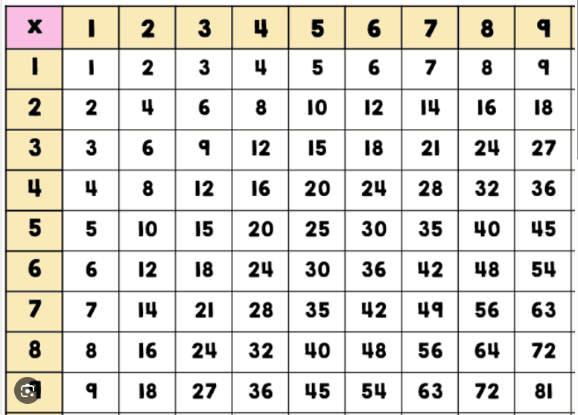
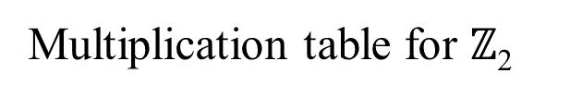
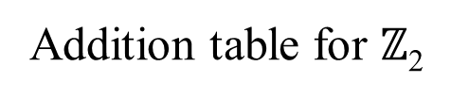
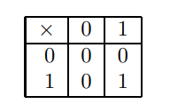
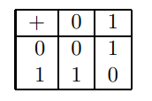
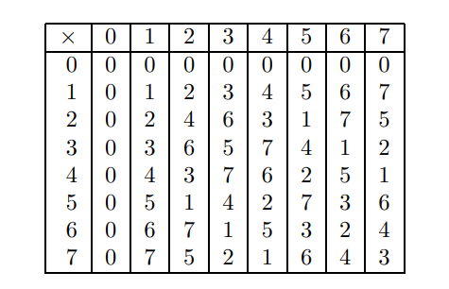
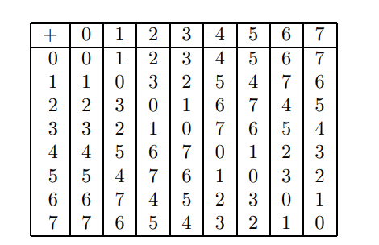
Multiplication table for GF(2³)
Addition table for GF(2³)
Slide <number>

Slide 40
BCH Codes
Correct the deficiency of Reed-Solomon code; have a fixed alphabet
We usually choose the alphabet {0, 1}
BCH(15, 7) code: Capable of correcting any two errors
Generator polynomial: g(x) = 1 + x⁴ + x⁶ + x⁷ + x⁸
1000 1000
0100 0001
0010 0011
0001 0101
1100 1111
0110 1000
0011 0001
1101 0011
1010 0101
0101 1111
1110 1000
0111 0001
1111 0011
1011 0101
1001 1111
BCH(511, 493) used as DEC code in a video coding standard for videophones
[0 1 1 0 0 1 0 1 1 0 0 0 0 1 0] ×
= [x x x x x x x x]
Received word
Syndrome
BCH(40, 32) used as SEC/DED code in ATM
Parity check matrix
Part IV – Errors: Informational Distortions
Nov. 2020
Slide <number>
Notes:
<number>
Example from: Hankerson, R. et al., Coding Theory and Cryptography: The Essentials, Marcel Dekker, 2000, p. 120.

Slide 41
14.5 Arithmetic Error-Correcting Codes
––––––––––––––––––––––––––––––––––––––––
Positive Syndrome Negative Syndrome
error mod 7 mod 15 error mod 7 mod 15
––––––––––––––––––––––––––––––––––––––––
1 1 1 –1 6 14
2 2 2 –2 5 13
4 4 4 –4 3 11
8 1 8 –8 6 7
16 2 1 –16 5 14
32 4 2 –32 3 13
64 1 4 –64 6 11
128 2 8 –128 5 7
256 4 1 –256 3 14
512 1 2 –512 6 13
1024 2 4 –1024 5 11
2048 4 8 –2048 3 7
––––––––––––––––––––––––––––––––––––––––
4096 1 1 –4096 6 14
8192 2 2 –8192 5 13
16,384 4 4 –16,384 3 11
32,768 1 8 –32,768 6 7
––––––––––––––––––––––––––––––––––––––––
Error syndromes for weight-1 arithmetic errors in the (7, 15) biresidue code
Because all the syndromes in this table are different, any weight-1 arithmetic error is correctable by the (mod 7, mod 15) biresidue code
Part IV – Errors: Informational Distortions
Nov. 2020
Slide <number>

Slide 42
Properties of Biresidue Codes
Biresidue code with relatively prime low-cost check moduli A = 2ª – 1 and B = 2^{b} – 1 supports a × b bits of data for weight-1 error correction
Representational redundancy = (a + b)/(ab) = 1/a + 1/b
n | k
7 | 4
15 | 11
31 | 26
63 | 57
127 | 120
255 | 247
511 | 502
1023 | 1013
a | b | n=k+a+b | k=ab
3 | 4 | 19 | 12
5 | 6 | 41 | 30
7 | 8 | 71 | 56
11 | 12 | 143 | 120
15 | 16 | 271 | 240
Compare with Hamming SEC code
Part IV – Errors: Informational Distortions
Nov. 2020
Slide <number>

Slide 43
Arithmetic on Biresidue-Coded Operands
Similar to residue-checked arithmetic for addition and multiplication, except that two residues are involved
Divide/square-root: remains difficult
D(x)
D(z)
D(y)
B
s
Arithmetic processor
with biresidue checking
s
Part IV – Errors: Informational Distortions
Nov. 2020
Slide <number>

Slide 44
14.6 Other Error-Correcting Codes
Reed-Muller codes: Have a recursive construction, with smaller codes used to build larger ones
Data
Turbo codes: Highly efficient separable codes, with iterative (soft) decoding
Encoder 1
Code
Interleaver
Encoder 2
Low-density parity check (LDPC) codes: Each parity check is defined on a small set of bits, so error checking is fast; correction is more difficult
Information dispersal: Encoding data into n pieces, such that any k of the pieces are adequate for reconstructing the data
Part IV – Errors: Informational Distortions
Nov. 2020
Slide <number>
Notes:
<number>
The two encoders for Turbo codes are generally identical. Soft decoding means that each of two decoders provides an assessment of the probability of a bit being 1. The two decoders then exchange information and refine their estimates iteratively. Turbo codes are extensively used in cell phones and other communication applications.

Slide 45
Higher-Level Error Coding Methods
We have applied coding to data at the bit-string or word level
It is also possible to apply coding at higher levels
Data structure level – Robust data structures
Application level – Algorithm-based error tolerance
Part IV – Errors: Informational Distortions
Nov. 2020
Slide <number>
Notes:
<number>

Slide 46
Preview of Algorithm-Based Error Tolerance
Error coding applied to data structures, rather than at the level of atomic data elements
Example: mod-8 checksums used for matrices
Matrix M
Row checksum matrix
2
1
6
2
1
6
1
M =
5
3
4
M _{r} =
5
3
4
4
If Z = X × Y then Z_{f} = X_{c} × Y_{r}
3
2
7
3
2
7
4
Column checksum matrix
Full checksum matrix
In M_{f}, any single error is correctable and any 3 errors are detectable
2
1
6
2
1
6
1
5
3
4
5
3
4
4
M _{c} =
M _{f} =
3
2
7
3
2
7
4
Four errors may go undetected
2
6
1
2
6
1
1
Part IV – Errors: Informational Distortions

